Slide 1

Projetando e Implementando Cloud Services
Evilázaro Alves
Microsoft Regional Director | Microsoft Azure MVP
www.evilazaro.com.br
evilazaro@outlook.com
@evilazaro

Slide 2
Instrutor
Dados

Slide 3
Agenda
Arquitetura do Cloud Services
Desenvolvendo um Cloud Service
Implantando um Cloud Service
Monitorando Cloud Services

Slide 4

Arquitetura do Cloud Services

Slide 5
Cloud Services - Plataforma Como Serviço no Azure
Os Serviços de Nuvem são uma Plataforma como Serviço do Azure que dá suporte a aplicativos que são escalonáveis, confiáveis e ao mesmo tempo, oferecem a você controle sobre as máquinas virtuais.

Slide 6
Web Sites vs. Cloud Services vs. Virtual Machines
Controle
Suporte Apps Legadas
Fácil Gerenciar
Agiliadde
Controle
Suporte Apps Legadas
Fácil Gerenciar
Agiliadde
Controle
Suporte Apps Legadas
Fácil Gerenciar
Agiliadde

Slide 7
O que é um Cloud Service?
Uma coleção de “service roles” relacionadas
Web Role
Worker Role

Slide 8
O que eu consigo rodar em um Cloud Service?
Propósito Geral
Se roda no Windows, roda no Microsoft Azure
Escolha sua linguagem
C#, VB, C++, Java, PHP, Node.js, Phython, etc.
Escolha seu Framework
.NET, ExpressJS, Rails, Zend, etc.

Slide 9
Web Roles
Windows Server pré-configurado
IIS Pré-instalado
Firewall configurado com a porta 80
Default Endpoint para porta 80
Você pode executar praticamente qualquer workload IIS em uma Web Role
Customizável com startup scripts

Slide 10
Worker Roles
Windows Server pré-configurado
Nada mais instalado
Sem endpoints Azure por padrão
Roda workloads customizados que não requerem o IIS instalado
Instalação de software adicional usando scripts
Implementação da lógica da solução na classe WorkerRole.cs

Slide 11
Roles vs. Instâncias
Role (“Template”)
Configuração
Família OS (Server 2008, 2012)
Tamanho da VM
Tipo da Role (Web, Worker)
Endpoints
Configurações
Etc…
Código
Mantenha pelo menos duas instâncias rodando para prover tolerância a falhas e SLA do Microsoft Azure.
Instância
*
VM Rodando, configurada, com código implantado, endpoints abertos, etc.

Slide 12
Scale Up (Escalonamento Horizontal)
Adicione mais instâncias para balancear a carga e prover tolerância a falhas quando a demanda aumentar.
Role (“Template”)
Configuração
Família OS (Server 2008, 2012)
Tamanho da VM
Tipo da Role (Web, Worker)
Endpoints
Configurações
Etc…
Código
Mantenha pelo menos duas instâncias rodando para prover tolerância a falhas e SLA do Microsoft Azure.
Scale Up
Instância
*
VM Rodando, configurada, com código implantado, endpoints abertos, etc.

Slide 13
Scale Down
Role (“Template”)
Remova instâncias quando não houver mais necessidade e a demanda estiver menor.
Configuração
Família OS (Server 2008, 2012)
Tamanho da VM
Tipo da Role (Web, Worker)
Endpoints
Configurações
Etc…
Código
Mantenha pelo menos duas instâncias rodando para prover tolerância a falhas e SLA do Microsoft Azure.
Scale Down
Instância
*
VM Rodando, configurada, com código implantado, endpoints abertos, etc.

Slide 14
Comportamento de Dados Web / Worker Roles
A “Platform as a Service” (PaaS) solution
Máquinas Virtuais (VMs) Pré-configuradas
Rodando Windows Server 2012 R2, 2012, or 2008
Você NÃO precisa instalar o SO
Você NÃO precias manter o SO
VMS SÃO STATELESS
Quando uma VM é “reciclada”, nenhum dado é preservado
Dados no storage local (local na VM) será perdido
Persista os dados em uma Azure Storage Table, Blog Storage ou SQL Azure
Role Virtual Machines

Slide 15
Azure Fabric Controller & Role Instance Recovery
Fabric Controller
Server Rack
Server Rack
Server Rack
Server Rack
Physical Servers
Physical Servers
Physical Servers
Physical Servers
VM
VM
VM
VM
VM
VM
VM
VM
VM
VM
VM
VM
VM
VM
VM
VM
VM
VM
VM
VM
VM
VM
VM
VM
VM
VM
VM
VM
VM
VM
VM
VM
VM
VM
VM
VM
VM
VM
VM
VM
VM
VM
VM
VM
VM
Tables / Queues/ Blobs / Azure SQL Database
Data
Data

Slide 16
Cloud Services
Microsoft Azure Data Center
Cloud Service (cloudservicename.cloudapp.net)
Storage (accountname.*.core.windows.net)
Web Role
Web Role
80
Load Bal.
SQL Database (server.database.windows.net)
Firewall
Worker Role
8081
Worker Role
?
?
Monte de outras coisas legais que você poderá usar….
Virtual Machine
1433

Slide 17
Criando um Cloud Service usando o Portal

Slide 18


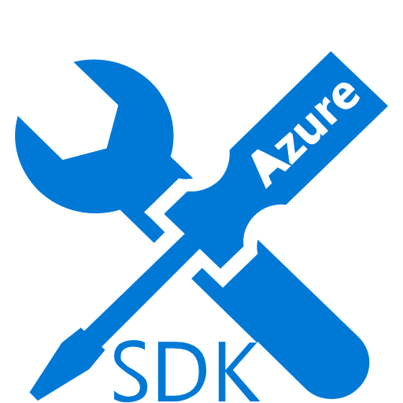
Desenvolvendo um Cloud Service

Slide 19
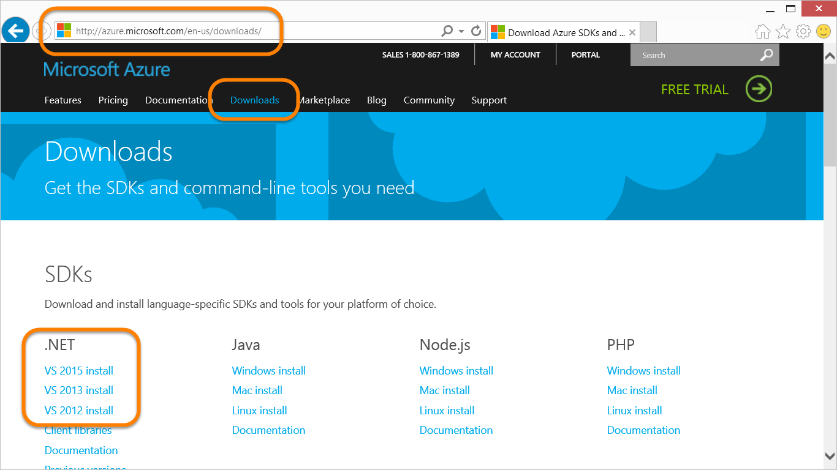
Azure SDK

Slide 20
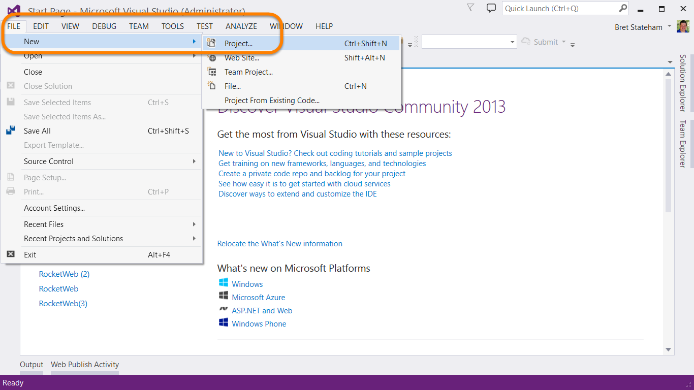
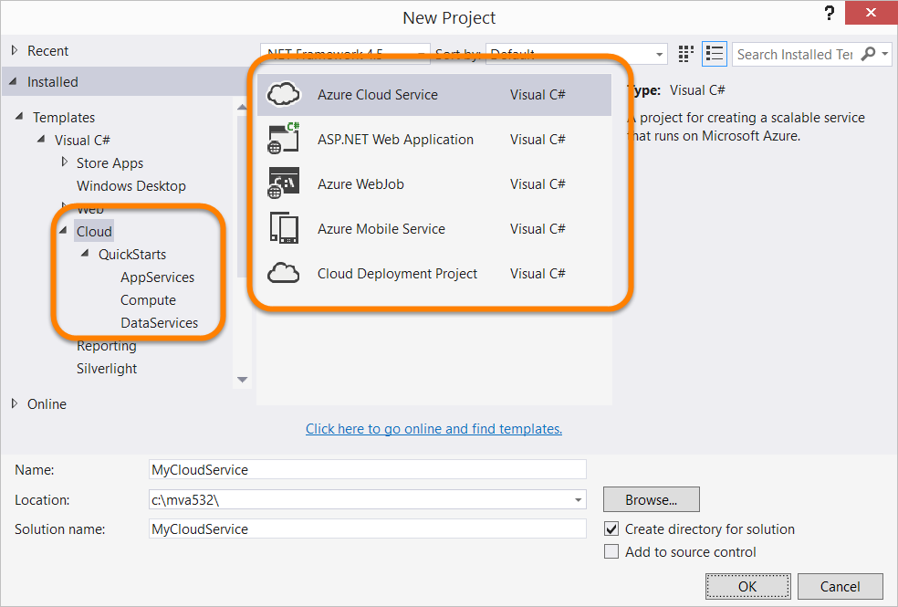
Visual Studio Project Templates

Slide 21
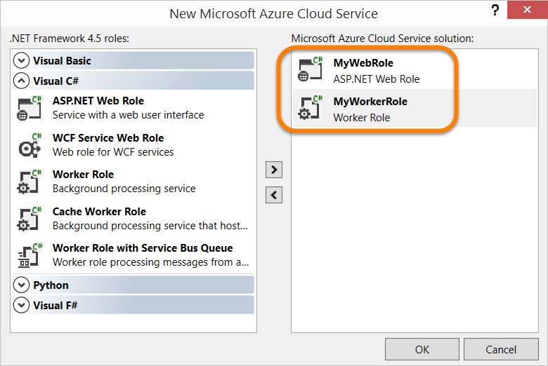
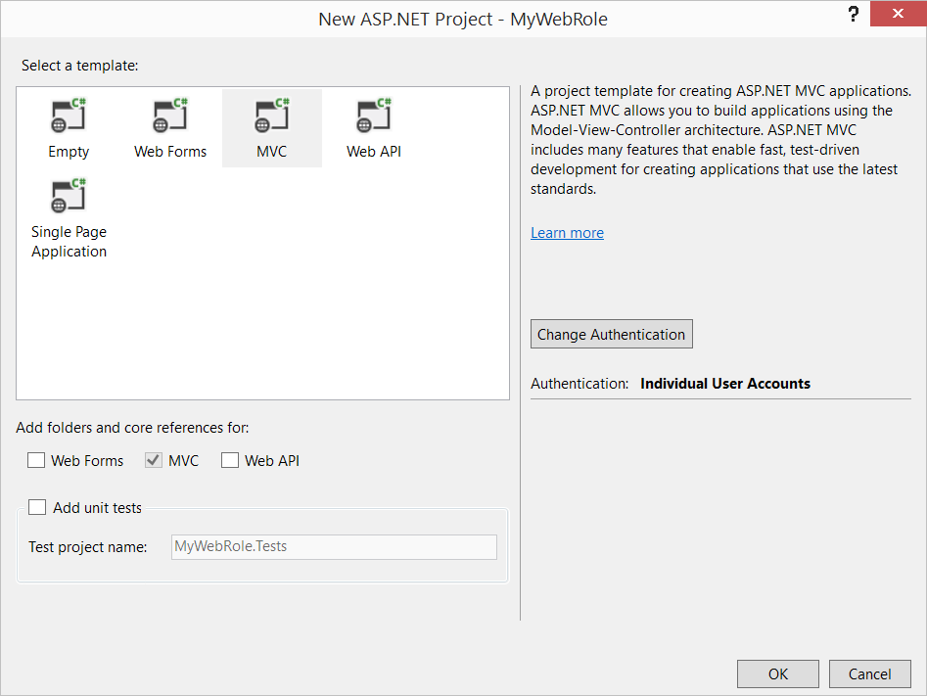
Adicionando e Configurando Cloud Service Role Projects

Slide 22
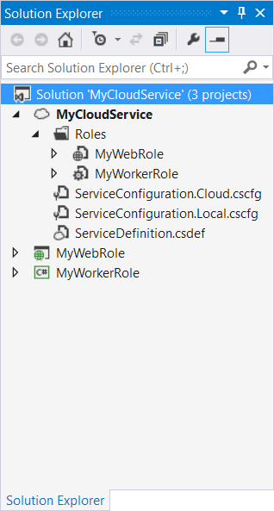
Cloud Service & Roles no Solution Explorer
Cloud Service Project
Configuração Files (*.cscfg)
Arquivo de Definição (ServiceDefinition.csdef)
Web Role Project(s)
Projeto ASP.NET Default
Referências para as bibliotecas do azure
WebRole.cs RoleEntryPoint
Worker Role Project(s)
Projeto Class Library Default
Referências para as bibliotecas do Azure
WorkerRole.cs RoleEntryPoint

Slide 23
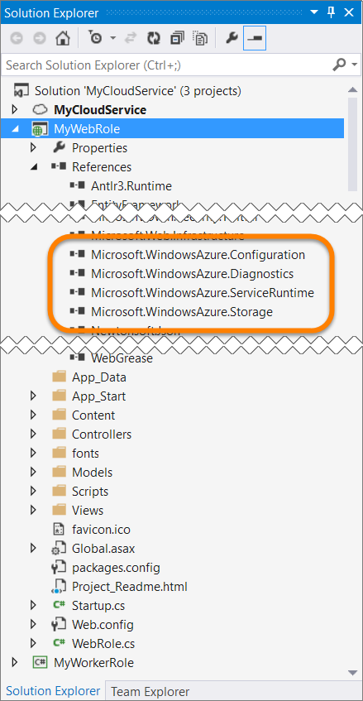
Microsoft.WindowsAzure.* Assembly References
Microsoft.WindowsAzure.Configuration
Contém a classe CloudConfigurationManager
Microsoft.WindowsAzure.Diagnostics
Classes de diagnósticos e monitoramento
Classes de gerenciamento de diagnósticos
Microsoft.WindowsAzure.ServiceRuntime
Role, RoleEntryPoint, & RoleEnvironment classes
Microsoft.WindowsAzure.Storage
Classes para trabalhar com Tables, Blobs e Queues

Slide 24
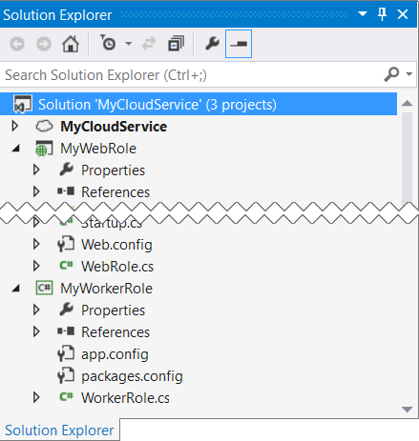
Implementação da Classe RoleEntryPoint Class
Chamada pelo Service Runtime
Usada para gerenciar o tempo de vida da role
Nomes das Classess
WebRole.cs para Projetos Web Role
WorkerRole.cs para Projetos Worker Role
Virtual Methods
OnStart()
OnStop()
Run()

Slide 25

Arquivo ServiceDefinition.csdef
Usado para configurar:
<WebRole />
<Sites />
<WorkerRole/>
<InputEndpoints />
<InstanceInputEndpoints />
<InternalEndpoints />
<ConfigurationSettings />
<Certificates />
<LocalResources />
<Imports />
<Startup />
Mudanças requerem que o pacote seja re-implantado

Slide 26
Arquivos ServiceConfiguration.*.cscfg
ServiceConfiguration.*.cscfg
Versão “Cloud” usada por padrão quando implantar na nuvem (Microsoft Azure)
Versão “Local” usada por padrão quando está depurando localmente
Usado para configurar:
<Instances />
<ConfigurationSettings />
<Certificates />
Deve corresponder aos valores pré-definidos em ServiceDefinition.csdef
Pode ser aletrado sem necessidade de re-implantar o pacote

Slide 27
Emuladores de Computação e Storage
Shipped as part of the Azure SDK
Two Versions of the Compute Emulator
Full Emulator
Original Emulator
Requires Visual Studio to be run as Administrator
Express Emulator
Only supports a single instance of each role
Does NOT require Visual Studio to be run as Administrator
Storage emulator uses SQL Server LocalDB by default
Use WAStorageEmulator.exe /init to point to a different instance

Slide 28
Desenvolvendo Cloud Services

Slide 29


Desenvolvendo Cloud Services

Slide 30
Two Independent Environments
Production
Staging
Notes:
Slide Objective
Microsoft Azure allows for 2 deployment packages as part of the same project, Production and Staging
Speaking Points
Staging Costs money to use
Flip around
Each package has a unique version for that project.
The “production” package services requests from the website URL. Worker roles operate normally.
Any package in “Staging” will only serve web requests from a temp URL – which is a GUID and is shown below the package. This is great to run smoke tests on.

Slide 31
Stages of Service Deployment
Stage 1: Local development and testing
Stage 2: Test in mixed mode with hosted data
Stage 3: Test in Staging on Microsoft Azure
Stage 4: VIP Swap to Production
Production
Staging
Compute Emulator
Compute Emulator
Role
Role
Cloud Service
Role
Role
Role
Role
Storage Emulator
Microsoft Azure Storage Service
Microsoft Azure Storage Service
Notes:
Slide Objective
Highlight the stages of a typical deployment
Local development
Hybrid of local and Microsoft Azure
Everything in Microsoft Azure in staging
Swap from Staging to Production
Speaking Points
Debugging is not currently supported in Microsoft Azure
Set breakpoints & debug in Local Development Fabric.
Test initially with development storage, but test with Microsoft Azure storage to test with large volumes of data whilst still keeping your roles local for debugging
Once you are happy with the Worker/Web Roles running locally deploy everything to Staging and run tests in this environment
Once all tests in staging pass, promote everything to production
Worker roles in the “Staging” project are operational – and as such will process messages from queues etc. You should design for this.

Slide 32
Packaging & Deployment
Azure Data Center Fabric Controller
Cloud Service
Deployment Slot Production or Staging
ServiceConfiguration.cscfg
Web Role
Web Role
Package (*.cspkg zip file)
80
Firewall
Load Bal.
csupload
cspack
Worker Role
Worker Role
?
Azure SDK command line tools
?

Slide 33
Packaging & Deployment
Service Artefacts
Upload to Microsoft Azure
Microsoft Visual Studio
*.cspkg
Model
Microsoft Azure Compute Controller
Web Role
Worker Role
Config
*.cscfg
LB
You can also integrate with source control such as TFS and deploy via continuous integration
Visual Studio Tools for Microsoft Azure now supports one-click deployment. Aimed at rapid build/deploy/test/fix scenarios.
Service
Service
Notes:
Slide Objective
CODE – PACKAGE – UPLOAD – DEPLOY
Shows how service makes it from code living in Visual Studio to a running deployed instance in Microsoft Azure
Show how Roles are packaged up and uploaded with the config to Microsoft Azure
Speaking Points
Code is compiled, then packaged into a single file. This is the service package.
This, along with the configuration/service model – are deployed via the web portal.
Notes
Visual Studio 11 with the updated tools now supports automated seamless package/upload/deploy using Service Mngt Api

Slide 34
Geo-Location & Affinity Groups
Dependent resources
Ensures geo-location in single datacentre
Can specify sub-region also (Recommended)
Affinitized
Explicitly define sub-region on service by service basis
Specific Geo-located
Microsoft Azure chooses sub-region
(Not Recommended)
Un-Affinitized
Affinity and Geo-Location Settings are Immutable
Notes:
Slide Objective
Highlight the different options available when deploying services to Microsoft Azure around Affinity Groups
Speaking Points
Microsoft Azure Storage can be geo located, meaning you can choose in which geographical region it will be hosted
Different geographical regions have different implications when it comes to cost
Reason for geo-location
Legal
Business Continuity / Backup
Associate data with Microsoft Azure services through an ‘Affinity Group’
Affinity Group helps the Microsoft Azure Fabric Controller keep services & data close together within the data centre
Reason for affinity grouping is Performance
The Microsoft Azure data-centre’s are so large that by having data and services located near each other can improve performance
Fewer network hops
lower communication times

Slide 35
Guest OS Versioning
Microsoft Azure Runs on Base OS
Base OS revised regularly
Best practice is to specify OS version
Get latest version by default – using version ‘*’ gets auto-updates
Use osVersion attribute
To determine version in the cloud view config data in cloud
<ServiceConfiguration serviceName="CloudService1" osVersion="WA- GUEST-OS-3.2_201302-01“>
Releases posted here: http://msdn.microsoft.com/ee924680
Release | Guest OS
WA-GUEST-OS-3.2_201302-01 | Windows Server 2012 .NET 4.0/4.5 SDK 1.8 and newer
WA-GUEST-OS-2.14_201302-01 | Windows Server 2008 R2 .NET 3.5/4.0 SDK 1.3 and newer
WA-GUEST-OS-1.22_201302-01 | Windows Server 2008 SP2 .NET 3.5 SDK 1.8 and newer
Notes:
Slide Objective
Microsoft Azure runs on a base operating system
This guest operating system is updated regularly
Guest OS Version can be and should be specified in the service configuration file
Speaking Points
Best practice is to always specify the version of the OS to run on.
Roles will try to run on the latest available version if you don’t specify a version
To ensure that your service works as expected, you must deploy it to a release of the Microsoft Azure guest operating system that is compatible with the version of the Microsoft Azure SDK with which you developed it.
“It works on my machine” – something working on local development fabric and not in the cloud could be a result of incompatibilities
All role instances defined by your service will run on the guest operating system version that you specify
Services may be subject to upgrades to the underlying Microsoft Azure root operating system from time to time.
Mandatory and cannot be postponed.
An upgrade to the root OS recycles your running role instances, taking them through their shutdown sequences and then restarting them.

Slide 36
Fault & Upgrade Domains
Fault Domains
Represent groups of resources anticipated to fail together
i.e. Same rack, same server
Fabric spreads instances across fault domains
Default of 2
Upgrade Domains
Represents groups of resources that will be upgraded together
Specified by upgradeDomainCount in ServiceDefinition
Default of 5
Fabric splits Upgrade Domains across Fault Domains and Across Roles
Notes:
Slide Objective
Discuss achieving very high availability with Microsoft Azure
Speaker Notes
Fault Domain is a physical unit of failure, and is closely related to the physical infrastructure in the data centers.
In Microsoft Azure the rack can be considered a fault domain. However there is no 1:1 mapping between fault domain and rack.
Microsoft Azure Fabric is responsible to deploy the instances of your application in different fault domains.
Obviously this only applies if you run more than 1 instance
Right now Fabric makes sure that your application uses at least 2 (two) fault domains, however depending on capacity and VM availability it may happen that it is spread across more than that.
As a developer u have no direct control over how many fault domains your application will use but the way you configure it may impact your availability
Upgrade Domain is a logical unit, which determines how particular service will be upgraded.
The default number of upgrade domains that are configured for your application is 5 (five). You can control how many upgrade domains your application will use through the upgradeDomain configuration setting in your service definition file (CSDEF).
Microsoft Azure Fabric ensures that particular upgrade domain is not within single fault domain
That is Upgrade domains are orthogonal to fault domains
Roles are then spread out over upgrade domains and fault domains. Subject to running a reasonable number of instances this removes the risk of a single point of failure

Slide 37
Example Service Model for Upgrade
Web Role
Worker Role
Web Role
Web Role
Four Instances
Four Instances
Notes:
Slide Objective
Introduce the very basic service model that we’ll be working with as we discuss fault and upgrade domains
Speaker Notes
We’ll be looking at fault an upgrade domains in the context of a very simple service
The model defines two roles- a worker and a we role
Each of these is running four instances

Slide 38
Roles and Instances Example role with nine virtual machines distributed across three fault domains
Network Load Balancer
Role
Fault Domain 1
Fault Domain 2
Fault Domain 3
VM₁
VM₃
VM₂
VM₄
VM₆
VM₉
VM₅
VM₈
VM₆
VM₉
Notes:
Slide Objective
Understand what a scale-out application looks like
Speaking notes
High scale applications often follow this sort of an pattern
Inbound connectivity comes through a load balancer
Requests are round robin routed
Load balancer is typically aware of the state of the web servers (i.e. are they up)
There are one or more tiers or groups of stateless web or app servers
By stateless we mean that they do not hold state between client requests
Stateless means that simple load balancing works – no need for sticky sessions
Stateless means that the failure of a web server does not cause major issues for application- it is simply removed from the load balancer
A stateful or storage tier
This will generally involve some sort of scale out approach for large apps
Often using partitioned databases
Often some sort of queuing mechanism
Applications will often perform processing in the background.
Improves response time for users
Allows load peaks to be buffered in queues
Microsoft Azure provides us with a Platform as a Service offering to implement these sorts of applications
Notes
http://msdn.microsoft.com/en-us/magazine/cc500561.aspx
http://msdn.microsoft.com/en-us/library/ff650667.aspx

Slide 39
Fault and Upgrade Domains
Fault Domain
Fault Domain
Rack
Rack
Web Role
Web Role
U/G Domain #1
VM
VM
U/G Domain #2
VM
VM
Worker Role
Worker Role
U/G Domain #1
VM
VM
U/G Domain #2
VM
VM
Notes:
Slide Objective
Provide a graphical view of fault and upgrade domains
Speaker Notes
You can se that our service is well spread out across both fault and upgrade domains
The loss of a fault domain will not cause a failure of our service nor will the restart or change of an upgrade domain cause a failure of our service
Notes
Useful pre-reading here.
http://blog.toddysm.com/2010/04/upgrade-domains-and-fault-domains-in-windows-azure.html

Slide 40
VIP Swap
Swap Virtual IPs between the two slots
Production becomes Staging
Staging becomes Production
Allows to quickly swap environments
Essential for when service model has changed
Exception: Changing public endpoints requires delete deployment
No downtime incurred
Developer Portal & Service Management API
Maintains the same external IP address
For the Best User Experience Invest in warming up the same number of instances in Staging before swapping in to Production
Notes:
Objective
Introduce the VIP Swap mechanism
Speaker Notes
VIP swapping allows for minimal downtime upgrades by running two deployment slots
The load balancer is re-wired when a VIP swap is performed to change the deployment slot that is listening on the production URL (the production IP address also remains unchanged during a VIP swap)
You can upgrade your service by deploying a new package to the staging deployment slot and then swapping the staging and production deployments.
This type of upgrade is called a Virtual IP or VIP swap, as it swaps the addresses of the two deployments.
Both deployments remain online during the swap process.
If u do a VIP swap you should aim to be running the same number of instances in both slots prior to the swap
Ensure instances in staging are running and warmed (consider using inter role communication to warm up instances)
Do not want to VIP Swap a 100 instance role and suddenly grind to a halt while the machines JIT your code.
VIP-Swap is done between the Production and Staging deployments in Microsoft Azure
During VIP-Swap the VIP of the Production deployment is assigned to the Staging deployment, and the VIP of the Staging deployment is assigned to the Production one
(both VIPs are swapped – hence the term VIP-Swap)
Notes
Performing VIP Swap Upgrades
http://msdn.microsoft.com/en-us/library/ee517253.aspx

Slide 41
VIP Swap Upgrade
Deployment
Web Role
Worker Role
VM
VM
Load Balancer:
VM
VM
Prod
Prod
Deployment
Stage
Stage
Web Role
Worker Role
VM
VM
VM
VM
Notes:
Provides a diagrammatic view of a VIP Swap
Start with just the production slot deployed
Perform a deployment into the staging slot
The VIP swap is then performed repointing the IPs at the load balancer level.

Slide 42
In-Place Upgrade
Performs a rolling upgrade on live service
Leverages Upgrade Domains
Developer Portal & Service Management API
Automatic or Manual
Operating System Patches
Always assume you will have old and new versions of your service running side by side. Write version aware code!
Notes:
Slide Objective
Introduce rolling upgrades
Speaker Notes
A rolling upgrade redeploys your service 1 upgrade domain at a time.
Service model must be identical (ie. No new roles, no changes in .csdef, etc.)
If you specify manual, you then need to call the Walk Upgrade Domain operation to initiate the upgrade process for each upgrade domain
Note that you must walk the upgrade domains in sequence, beginning with the domain whose ID is 0. Attempting to walk upgrade domains out of sequence returns an error
Lose 50% of capacity if using 2 Upgrade Domains.
If you using 10 upgrade domains, you would lose 10% of your application at any one point
Notes
In Place Upgrades
http://msdn.microsoft.com/en-us/library/ee517255.aspx

Slide 43
In-Place Upgrade
Rack
Rack
Web Role
Web Role
#1
VM
VM
Load Balancer:
#2
VM
VM
Prod
Worker Role
Worker Role
#1
VM
VM
#2
VM
VM
Notes:
Animates an InPlace Upgrade

Slide 44
Upgrade Domains
Logical unit, which determines how particular service will be upgraded
Default number of upgrade domains that are configured for your application is 5 (five)
You can control how many upgrade domains your application will use through the

Slide 45
The High Scale Application Archetype Microsoft Azure provides a ‘pay-as-you-go’ scale out application platform
Intelligent Network Load Balancer
Network Activation
Stateless Web and/or Application Servers
Stateless ‘Worker’ Machines
Async Activation
State Tier
Queues
Key/Value Datastores
Partitioned RDBMS
Shared Filesystem
Notes:
Slide Objective
Understand what a scale-out application looks like
Speaking notes
High scale applications often follow this sort of an pattern
Inbound connectivity comes through a load balancer
Requests are round robin routed
Load balancer is typically aware of the state of the web servers (i.e. are they up)
There are one or more tiers or groups of stateless web or app servers
By stateless we mean that they do not hold state between client requests
Stateless means that simple load balancing works – no need for sticky sessions
Stateless means that the failure of a web server does not cause major issues for application- it is simply removed from the load balancer
A stateful or storage tier
This will generally involve some sort of scale out approach for large apps
Often using partitioned databases
Often some sort of queuing mechanism
Applications will often perform processing in the background.
Improves response time for users
Allows load peaks to be buffered in queues
Microsoft Azure provides us with a Platform as a Service offering to implement these sorts of applications
Notes
http://msdn.microsoft.com/en-us/magazine/cc500561.aspx
http://msdn.microsoft.com/en-us/library/ff650667.aspx

Slide 46
Deployment Slots
Cloud Service
Staging Deployment Slot
Production Deployment Slot
Production Deployment Slot
Staging Deployment Slot
?
?
?
?
Web Role
Worker Role
Web Role
Worker Role
Web Role
Worker Role
Web Role
Worker Role
Firewall
Load Bal.
Firewall
Load Bal.
80
80
CloudServiceName.cloudapp.net and Virtual IP (VIP1)
GUID.cloudapp.net and Virtual IP (VIP2)
VIP SWAP

Slide 47
Implantando Cloud Services

Slide 48



Monitorando Cloud Services

Slide 49
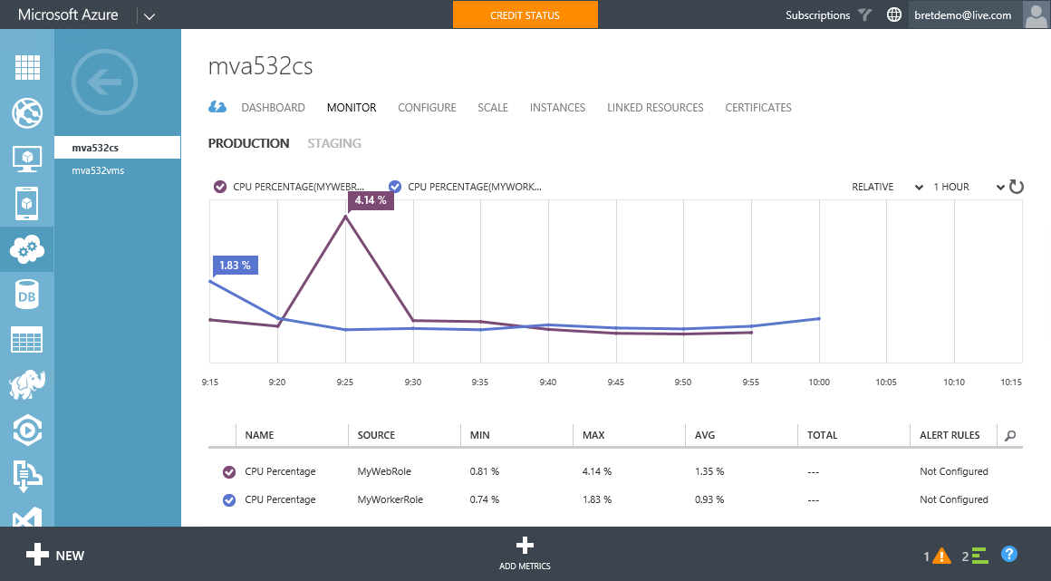
Monitoring via the Portal

Slide 50
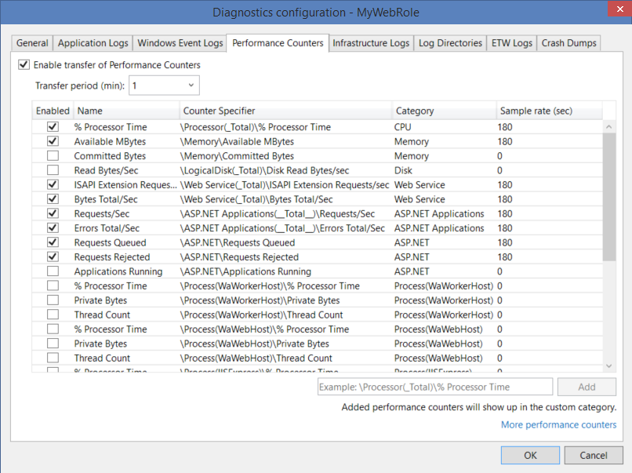
Diagnostics Monitoring
Collect Logs, Performance Counters and Trace data.
Data is transferred periodically to Azure Storage
Visual Studio can help you configure it!

Slide 51
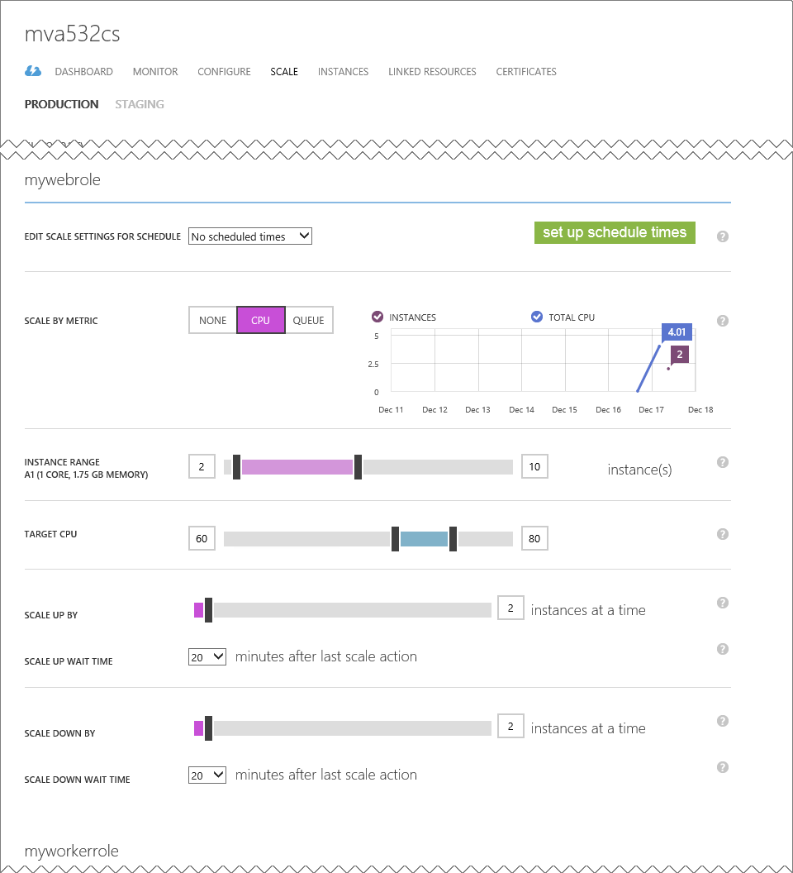
Auto Scale
Automatically scale up or scale down the number of instances for each role
Can be
Scheduled
Automatic based on CPU load
Automatic based on Queues
You can also manually scale using APIs

Slide 52
Monitorando Cloud Services

